Slide 1
Disclaimer
This training resource was developed to be used with the CZ ID platform
In October, 2026, stewardship of CZ ID transitioned to UCSF and the platform was renamed to SeqtoID
These training materials are not being actively maintained and may not reflect differences between CZ ID and SeqtoID, subsequent changes to the platform, or current methods and best practices in metagenomic sequencing and analysis

Slide 2

Introduction to CZ ID
Rapid Response – Updated Sept 2026
Notes:
Slides updated 09/2026

Slide 3
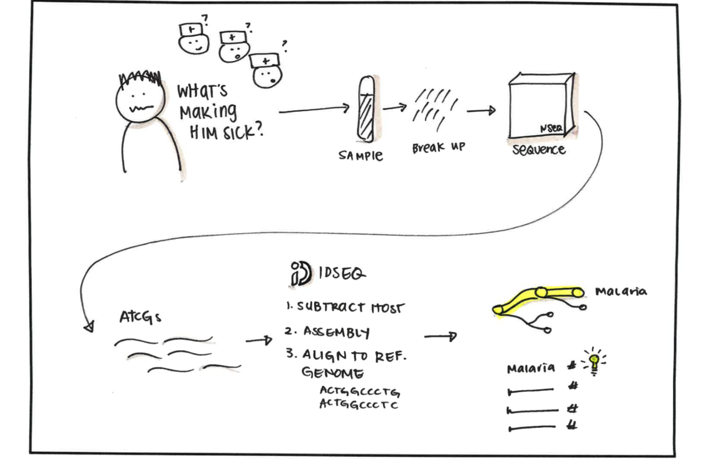
CZ ID is a free platform
used to identify microbes of interest from NGS data

Slide 4
CZ ID integrates bioinformatic tools to enable NGS analysis regardless of available computational resources
General Workflow:
Run Pipeline
(Integrates > 10 third party and custom tools)
Upload NGS Data
View, Analyze, and Download Results
Plug-and-play, cloud-based platform
(optimized for scalable Amazon Web Services (AWS) cloud deployment)
Notes:
No worries about storage solutions, easy data sharing

Slide 5
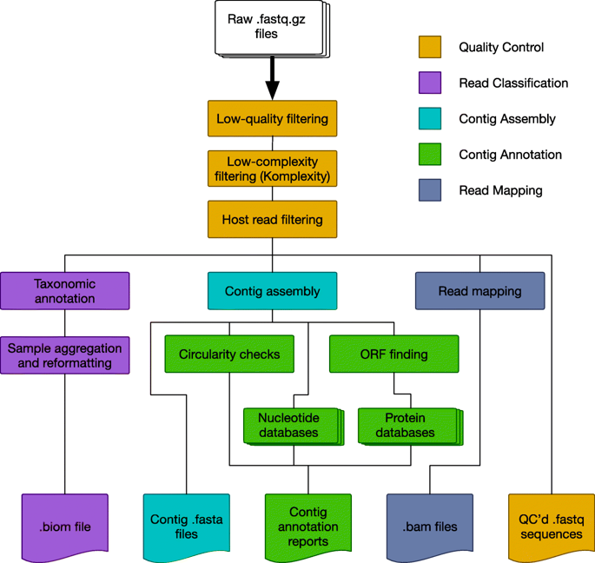
NGS data analysis requires computational power and includes MANY steps
Source: https://microbiomejournal.biomedcentral.com/articles/10.1186/s40168-019-0658-x, https://www.nature.com/articles/s41598-018-25022-6,
http://anaranalytics.com/whole-genome-sequencing/

Slide 6
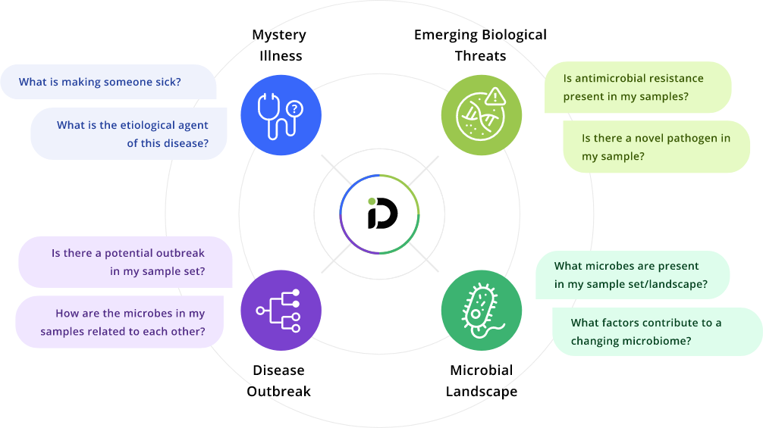
CZ ID supports multiple uses
CZ ID Pipelines:
Metagenomic (mNGS) analysis
Antimicrobial Resistance (AMR) gene detection
Viral consensus genome assembly

Slide 7
CZ ID supports multiple uses
Module | Input Sequencing Data | Supported Data
Metagenomics (mNGS) | Shotgun (or random) data Note: Module is NOT meant to process amplicon data (e.g., 16S, 18S, ITS) | Illumina & Nanopore
Antimicrobial Resistance (AMR) | Shotgun (or random) and whole genome sequence data | Illumina
SARS-CoV-2 | Metagenomic sequencing with spiked primer enrichment (MSSPE) and amplicon-based data (e.g., ARTIC v3 protocol) | Illumina & Nanopore
Viral Consensus Genomes | Target enrichment (e.g., MSSPE), PCR amplicon, whole genome, or metagenomic sequencing data | Illumina

Slide 8
CZ ID supports multiple uses
CZ ID Pipelines:
Metagenomic (mNGS) analysis
Antimicrobial Resistance (AMR) gene detection
Viral consensus genome assembly

Slide 9
CZ ID mNGS Analysis Highlights
With just a few clicks, easily:
  Evaluate sample quality
  Explore and evaluate identified taxa through interactive reports
  Compare samples using interactive heatmaps
  Generate viral consensus genomes
  Keep track of pipeline steps

Slide 10
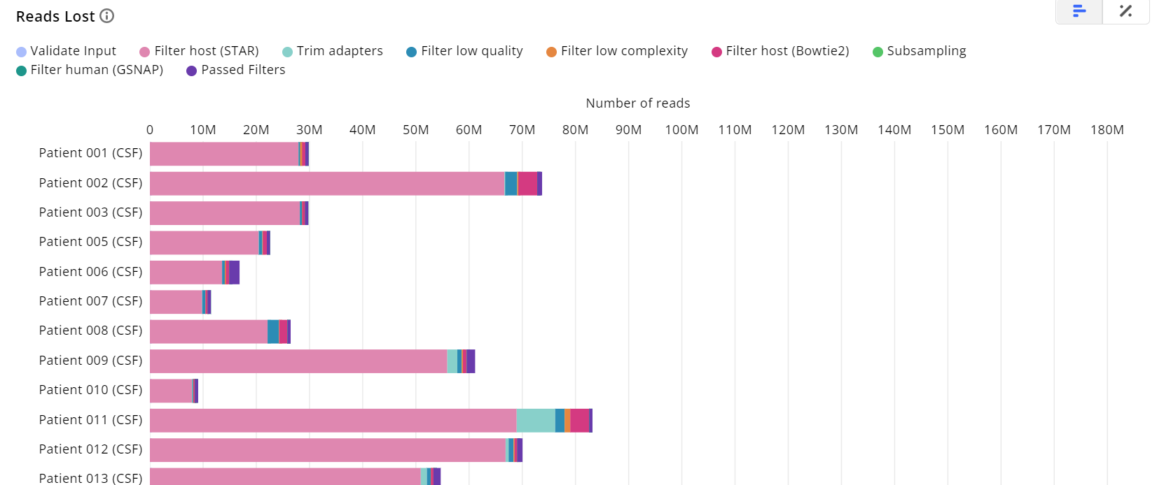
Perform QC

Slide 11
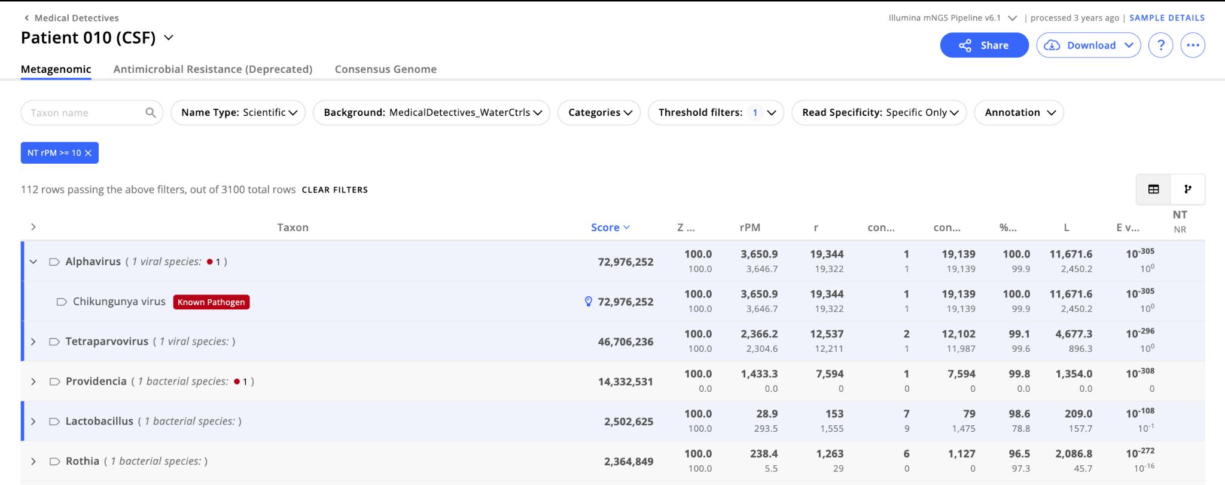
Explore and evaluate metrics for detected microbes

Slide 12
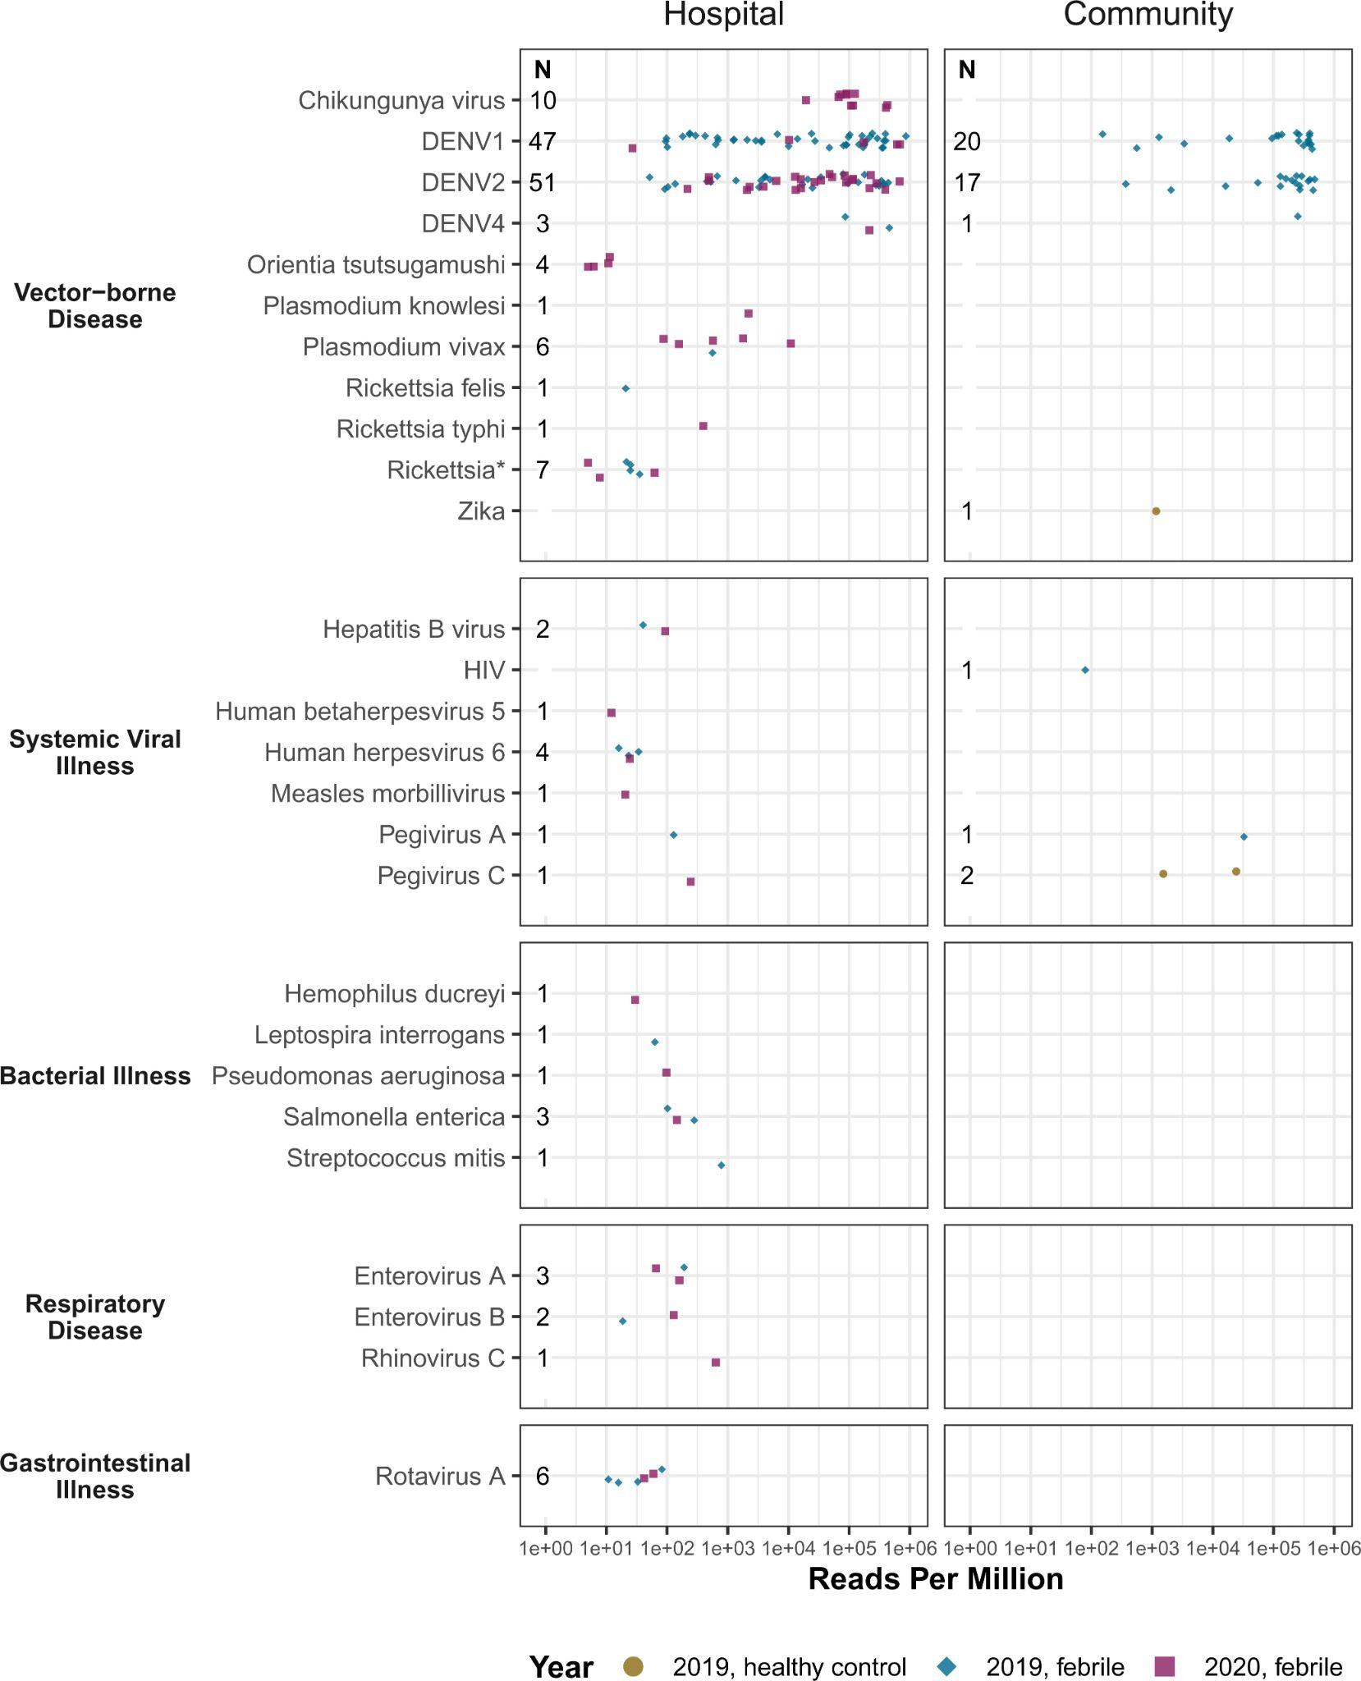
Example
Study: Pathogen landscape associated with febrile illness in Cambodia
Sample type: Serum
Results: 203 pathogens detected from 489 samples
Figure: Pathogens organized by disease category. Detection distinguished by participant cohort (community- (n = 87) vs hospital-based cohorts (n = 377)]
Bohl et al 2021
Notes:
92% (125 of 135) of DENV cases were from crop land
Early detection of chikungunya virus presaged a larger national outbreak of more than 6,000 cases

Slide 13
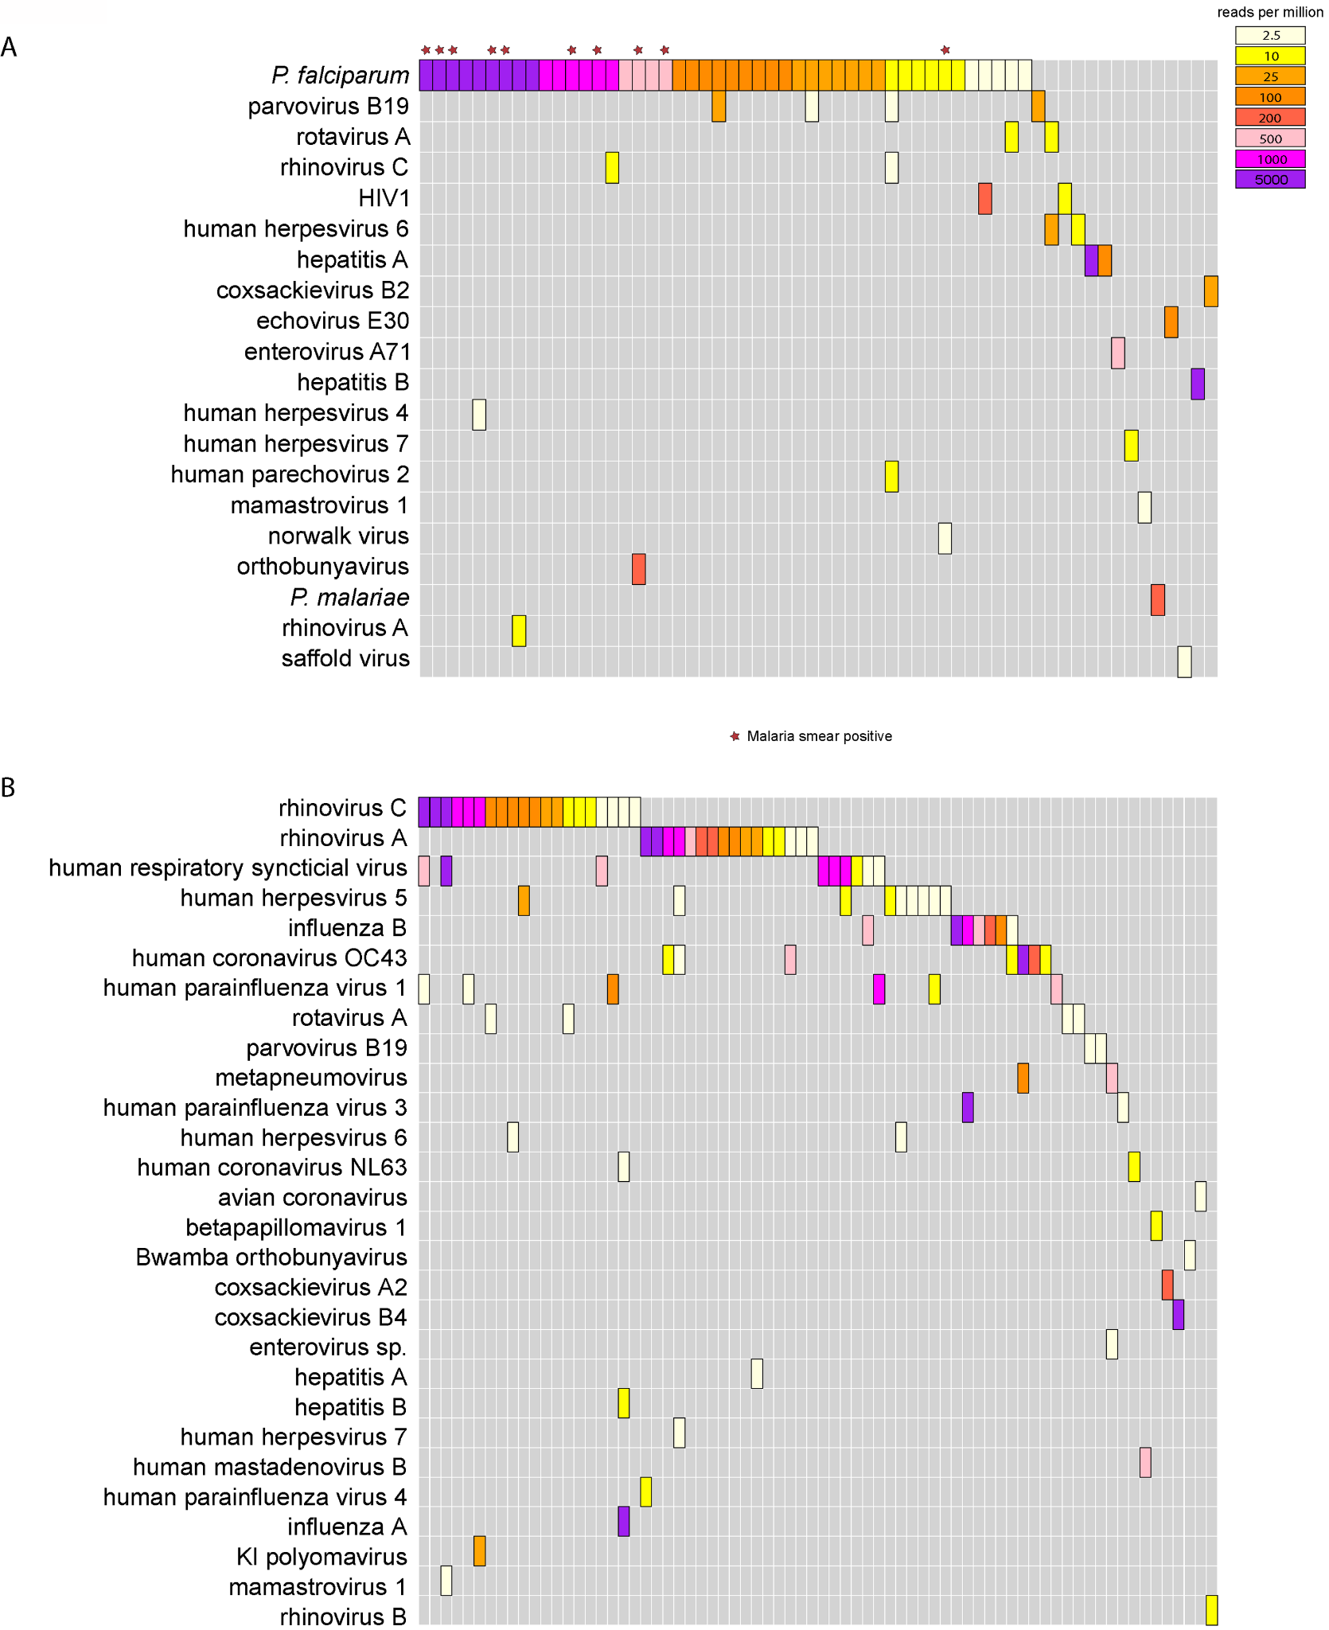
Serum
Example
Study: Pathogen landscape associated with pediatric febrile illness in Tororo, Uganda
Sample type: Serum and Nasopharyngeal (NP) swabs
Results: Pathogens detected in more than half of serum and NP samples.
Figure: Pathogens organized by sample type
*P. falciparum + (blood smear test)
NP Swabs
Ramesh et al 2019
Notes:
Most common in serum: Plasmodium falciparum (51.1% of samples) and parvovirus B19 (4.4%). P. falciparum was detected in 10/12 samples from patients reported as smear-positive. mNGS detected Plasmodium spp. in 37 additional samples that were smear negative (36 P. falciparum, 1 P. malariae)
The same microbial species was identified in the NP swab and serum samples from only six patients (on independent sequencing runs), one each with HRV-A, HRV-C, hepatitis A virus, hepatitis B virus, rotavirus A, and parvovirus B19.

Slide 14
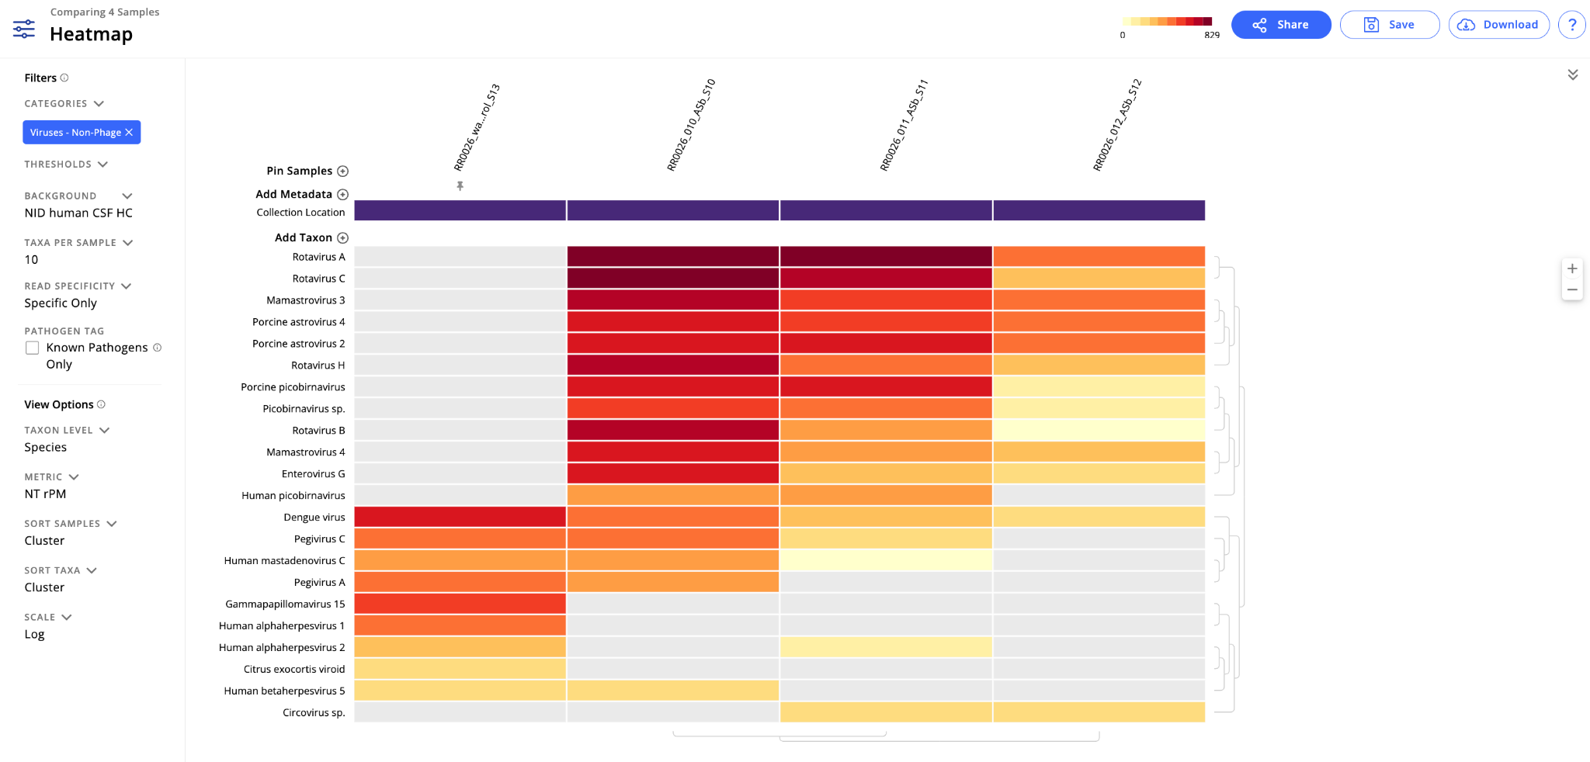
Compare samples visually to identify patterns of interest

Slide 15
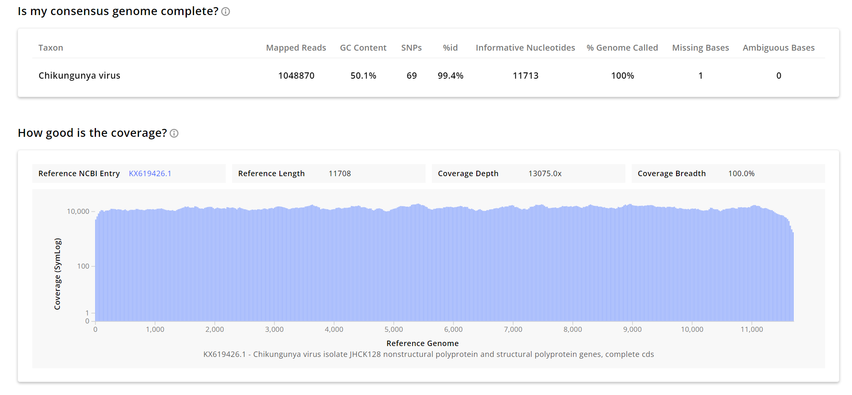
Create viral consensus genomes

Slide 16
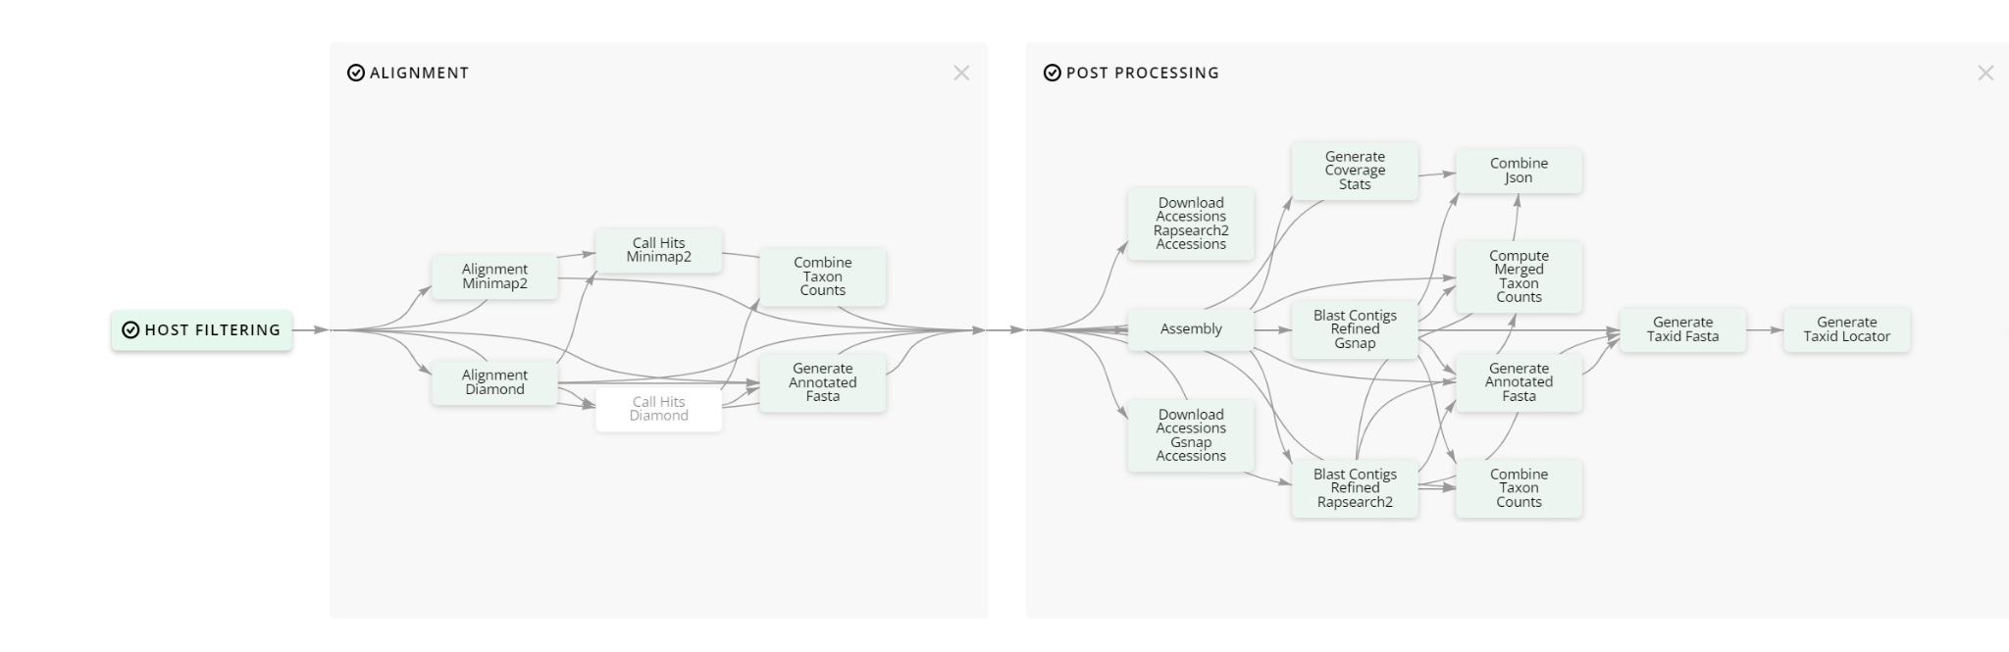
View pipeline steps and access intermediate files
Pipeline visualization

Slide 17
Publications Describing CZ ID Pipelines
CZ ID (formerly IDSeq) platform and mNGS Pipeline
  IDseq—An open source cloud-based pipeline and analysis service for metagenomic pathogen detection and monitoring
CZ ID AMR Pipeline
  Simultaneous detection of pathogens and antimicrobial resistance genes with the open source, cloud-based, CZ ID pipeline (preprint)
CZ ID Nanopore mNGS Pipeline
  CZ ID: a cloud-based, no-code platform enabling advanced long read metagenomic analysis (preprint)

Slide 18
Example Publications
Pathogen genomics in public health
Unbiased metagenomic sequencing for pediatric meningitis in Bangladesh reveals neuroinvasive Chikungunya virus outbreak and other unrealized pathogens
Integrating central nervous system metagenomics and host response for diagnosis of tuberculosis meningitis and its mimics
Metagenomic sequencing of post-mortem tissue samples for the identification of pathogens associated with neonatal deaths
Discovering disease-causing pathogens in resource-scarce Southeast Asia using a global metagenomic pathogen monitoring system

Slide 19
And more!
Let’s look at the pipeline…
But first, for ONT only: DL3-O_Prepare ONT fastqs for upload to CZ ID
Next Slides, Illumina: DL4-I_CZ ID mNGS Pipeline for Illumina
Next Slides, ONT: DL4-O_CZ ID mNGS Pipeline for ONT

